Slide 1
2nd Gen Gaming

Slide 2
The Basics
2nd gen gaming started around 1976 and ended with the discontinuation of the Atari 2600 in 1992
There were around 9 well known consoles from this ere, which include Fairchild, ColecoVision and of-course the Atari 2600.

Slide 3
Where it all Started
During the 2nd gen we saw the start of one of the biggest industries that we know today.
It saw the birth of Activision, a developer company that was started by four ex-employees from Atari.
Atari wasn't happy about this, but eventually found a way around it by charging royalties, with that the industry started to boom.

Slide 4
The Crash
By 1983 many companies tried to get their foot in the gaming door by creating more and more games for these consoles.
Even Quaker Oats tried their hand, by starting a company called “US Games” which closed after just one year of operation.
With all these companies developing content the market was now saturated.

Slide 5
The Crash
The consumer demand couldn't keep up with the supply and so the same companies that tried to get into the industry fell out just as quick.
There were other reasons for the crash but that was the main.
People saw this as the end of the gaming industry and Atari thought to fight off the decline they would announce a new console.

Slide 6
An End of an Era
The crash lasted roughly two years, before the crash gaming companies revenue peaked at around $3.2 Billion in 1983 but fell to only $100 Million in 1985 a 97% drop.
Atari didn’t release the console that they had announced, instead Nintendo ended the decay by releasing the NES in 1985 which became extremely popular across America by 1987.

Slide 7
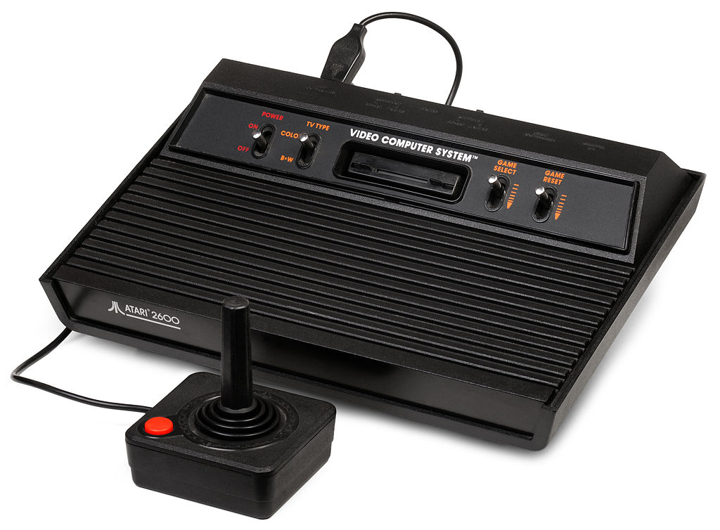
A New Dawn
By 1992 Atari discontinued the 2600 and that marked the end of the 2nd generation of gaming.

